Slide 1

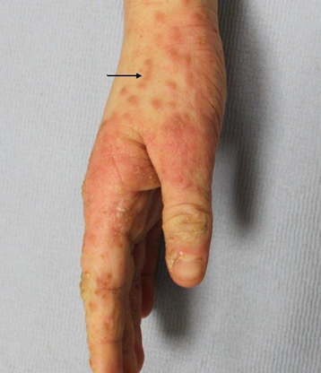
What is scabies?
How is scabies spread?
Scabies is transmitted through prolonged (approx. 10 mins or more) or frequent skin-to-skin contact with an affected person, for example, sharing a household setting, through the provision of personal care, or via sexual contact.
Transmission through casual contact, such as a handshake or a hug, is unlikely.
Scabies can also spread through contact with the clothes, bedding, or towels of someone who has scabies.
Scabies leaflet
Scabies is an infestation of the skin caused by a parasitic mite. The mites burrow under the top layer of the skin and lay eggs. The body’s immune system reacts to the mite’s droppings and saliva resulting in an immune reaction, which produces an intense itching.
Scabies is contagious, meaning it spreads from person to person through close contact.
Signs and symptoms
Intense itching, especially at night, that may affect most of the body or be limited to certain areas, commonly between fingers and toes, wrists, armpits, inner elbows, waist, groin, and buttocks.
A rash or skin irritation that looks like red or brown bumps, blisters, pimples,
Mite burrows on the skin with a zigzag or "S" pattern

Slide 2
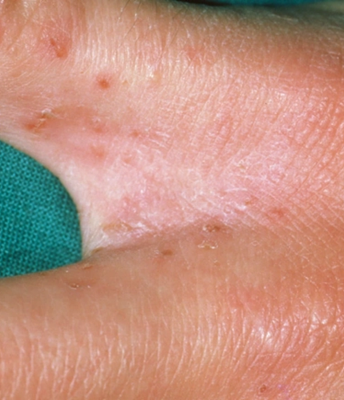

How do I apply the cream?
Get help for hard-to-reach places (e.g. your back) or consider using a spatula or putting cream plastic wrap and wiping over back as you do when using a towel to dry.
Wait for the cream to dry before putting on nightwear.
Apply to soles of feet last, just before getting into bed.
Do not put any other creams or lotions on your skin while you have the scabicide on
Leave the cream on for 8 to 12 hours (overnight treatment will ensure this)
The best time to apply treatment is before bedtime. Do not take a bath/shower immediately prior to applying the cream as this reduces its action on the skin. Skin must be dry and cool before cream is applied.
Remove all clothing and jewellery.
Apply thin layer of cream to the whole body – not just where the rash is.
Pay special attention to creases in the skin, between fingers and toes, under nails, armpits, and groin. If hands are washed within 8 hours of application, reapply the cream.
If you do not apply cream adequately or if close contacts are not treated at the same time reinfestation can occur.
It may take up to 6 weeks for the itching to stop, this does not mean treatment has failed.
How is scabies treated?
Cream is applied to the body on 2 occasions, 7 days apart. Permethrin 5% cream is the first line treatment.
Affected individuals do not need to exclude from school or work but should avoid close physical contact with other people until 24-hours after first treatment.
It is essential that all close contacts, e.g. household members and sexual partners. are treated at the same time to prevent reinfestation.
Laundry and Cleaning
Wash clothes, personal textiles (e.g., slippers, dressing gowns, towels/facecloths), and bed linen of case and contacts that have been used in the week before at a minimum of 50°C the morning after treatment.
Tumble dry on a hot cycle for at least 10 minutes if a hot wash has not been carried out.
Items that cannot be washed e.g., pillows/cushions should be placed in sealed plastic bag for 4 days.
Vacuum furniture, carpets, and mattresses for at least three days after treatment and clean hard surfaces with warm water and detergent.

